Slide 1
FINAL PLOJECT
Team 2
栃本 拓海, 野田 遼平, TSAI Chanchang, YE ZHUOBIN

Slide 2
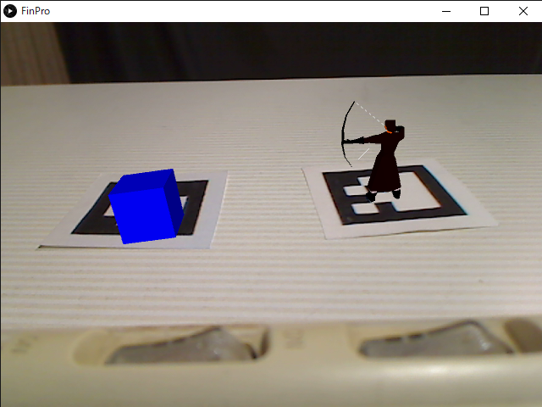
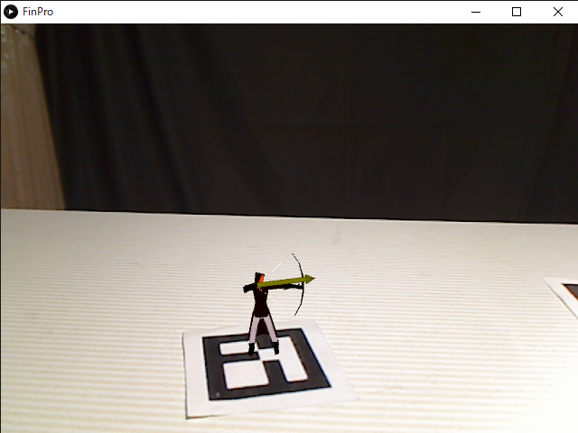
What we made
Archer stands on the marker and shoots an arrow at the target on the marker.
We use multiple markers.

Slide 3

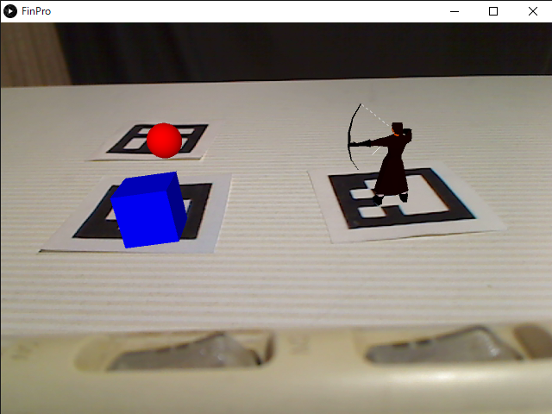
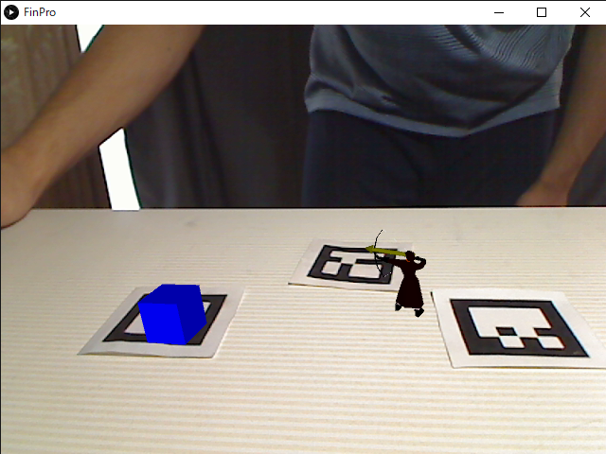
Detail
Case 1 : Number of markers = 1
Case 3 : Number of markers ≧ 3
Show an archer
Manual : An archer shoot the cube if sphere is closer than decided distance .
Case 2 : Number of markers = 2
An archer shoot cube if cube is closer than a threshold.
Not manual : An archer moves to other marker then shoots the cube.

Slide 4
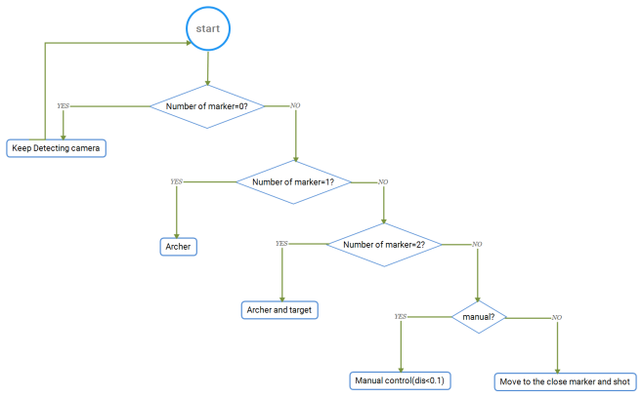
Cases

Slide 5
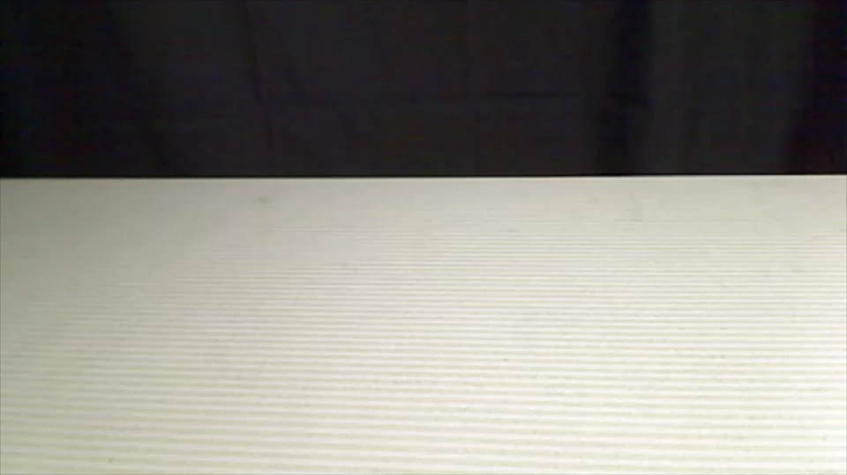
Case 0

Slide 6
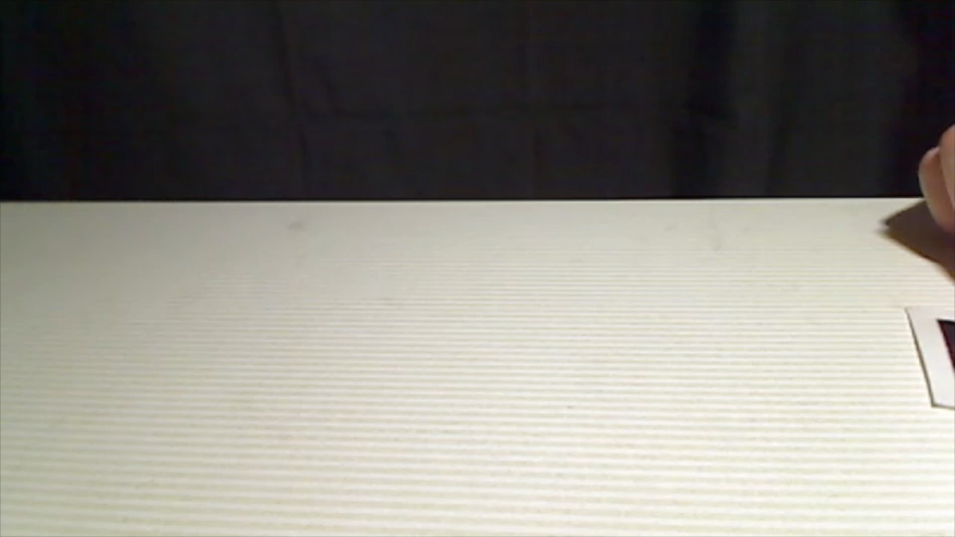
Case 1

Slide 7
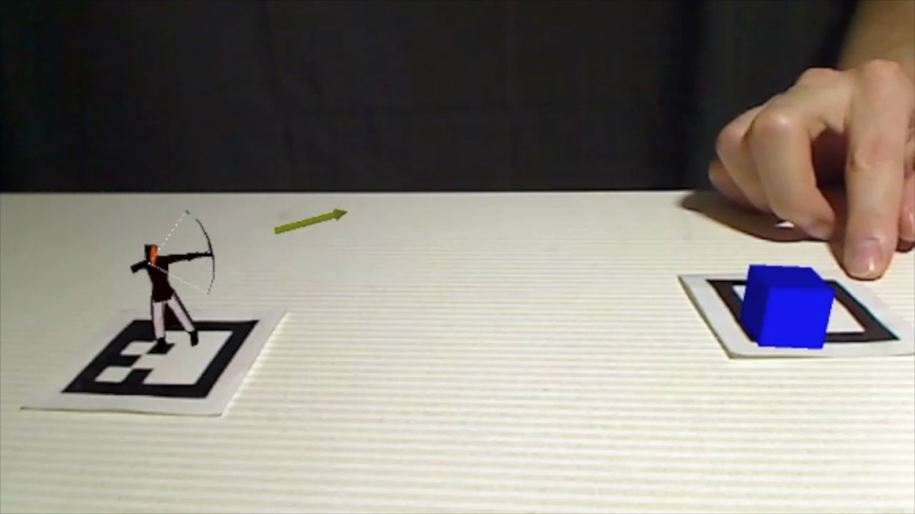
Case 2

Slide 8
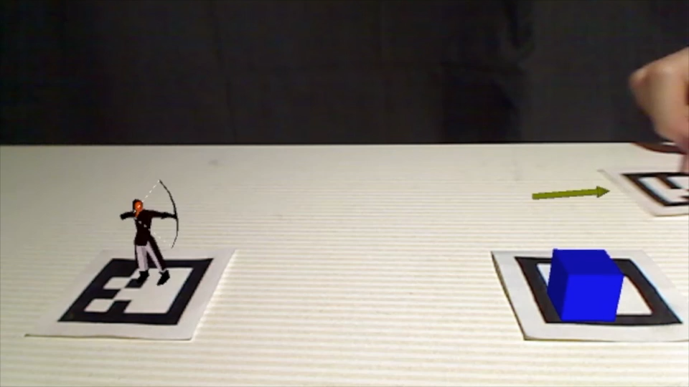
Case 3 (manual)

Slide 9
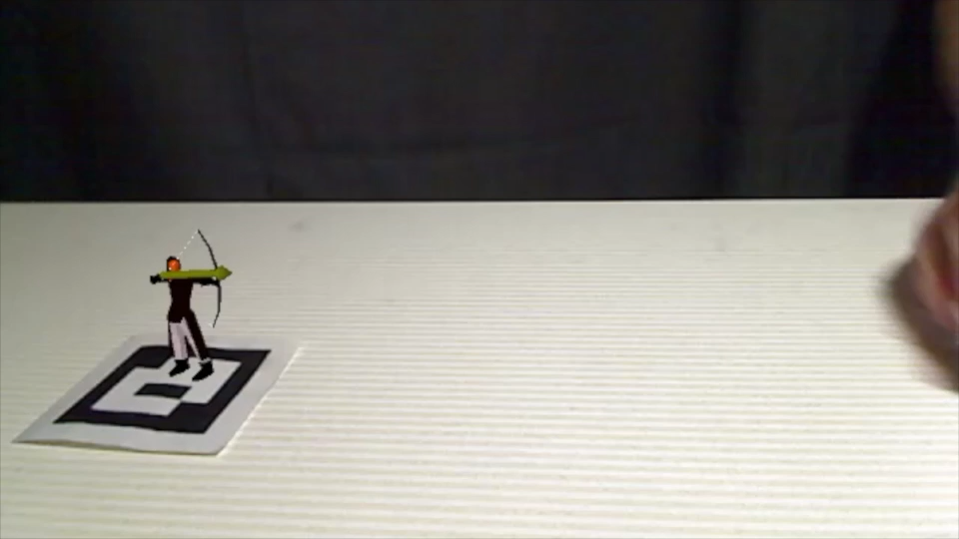
Case 3 (not manual)

Slide 10
How we made
Processing
models
Archer
Cube
Sphere
Rendering
Pose estimation of marker
Position estimation
Real World

